Slide 1
PDB
PDB Data Exploration

Slide 2
Agendas
Experiments
Data Parsing
Storing into NoSQL DB
Visualize from db
Possibilities
Use of graph database

Slide 3
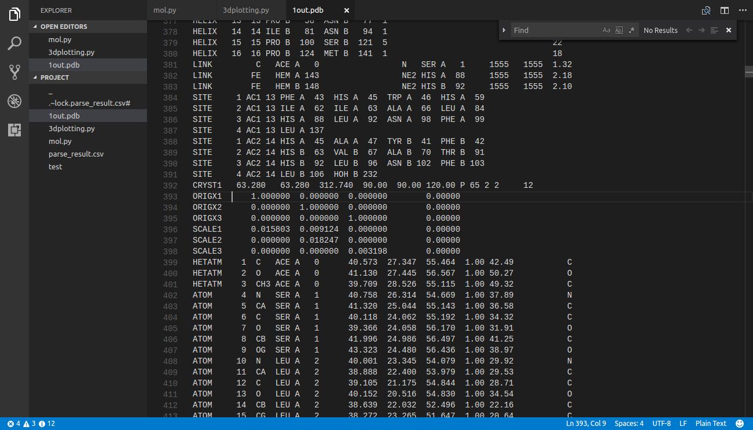
Data Parsing
Based on this pattern we can split data

Slide 4
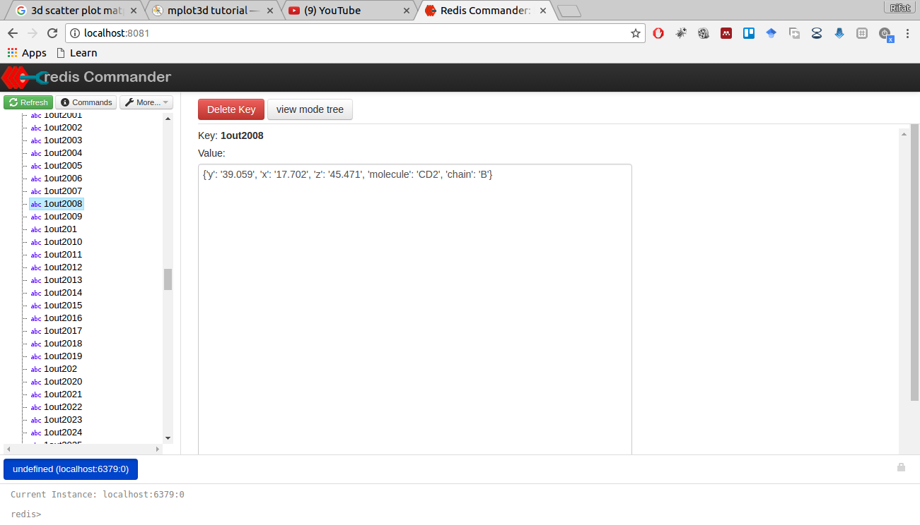
Storing into NoSQL DB
The result of the parsed data each atom with their x, y, z cordinate

Slide 5
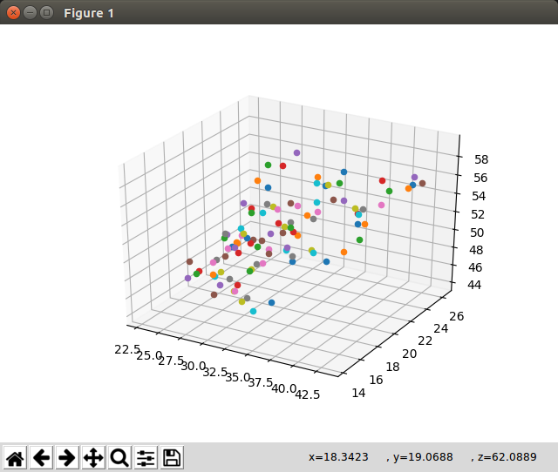
Visualize from DB
Plotted each atom in 3d coordination used(Matplotlib-python)

Slide 6
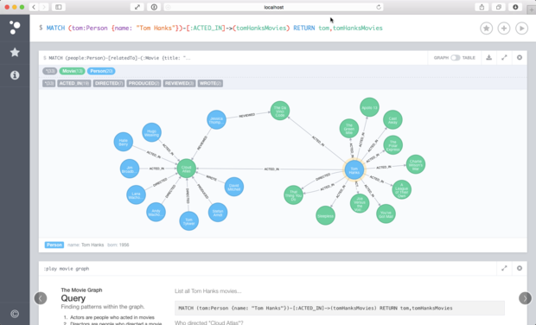
Use of Graph Database
The future plan of our analogy (neo4j a graph database management system)

